Slide 1
Graph based methods to identify drugs and metabolites in stroke patient urine
MRC DTP in Precision Medicine
Francesca Young

Slide 2
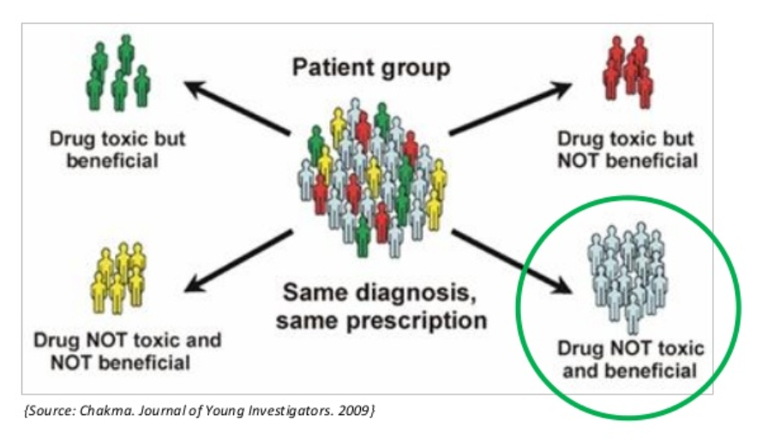
Precision Medicine
Giving the
Right treatment to the
Right patient at the
Right time in the
Right dose.
Modern medicine is data intensive.
Growing gap between our ability generate big data and ability analyse and
our ability to interpret this data.
Need for a new generation of bioinformatics tools.
Notes:
Tapping into massive data sets, omics data, electronic health records ,biobank data.
Traditional methods of programming has to use simplifying assumptions in order to model the system brings biases and limitations
New generartion of statistical and machine learning tools where the program learns the relationships from the data .
This project is about investigating Drug metabolism in stroke patients to further our understanding of inter-individual differences in drug disposition,
Strokes are the fourth biggest cause of death and the biggest cause of adult disability cost the country
There are currently several treatment statergies used on stroke patients but some patients do not respond to treatment or have adverse

Slide 3
Drug Metabolism
Enzymes evolved to deal with harmful substances ingested as part o diet
(eg animals that can eat toxic plants)
Process of converting a lipophilic molecule to polar molecule so can excreted
May include activation deactivation
Relatively few DME most have clinically relevant polymorphism
Genomics affect on drug metabolism not well understood.
Different approach

Slide 4
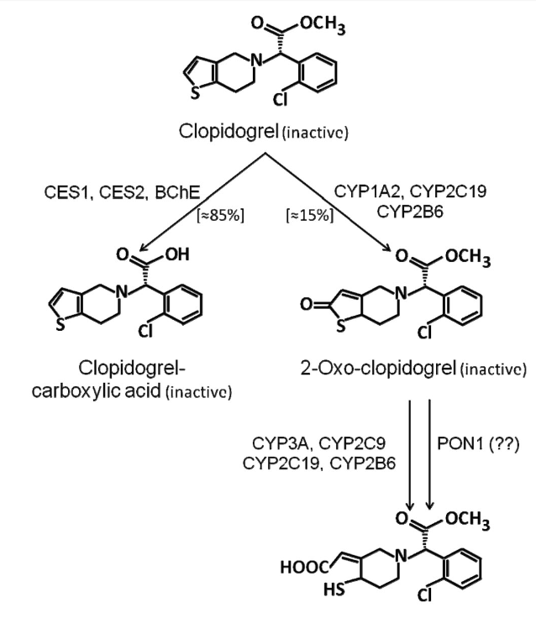
Drug Metabolism
Notes:
Evolution –
Process -
Pharmacogenomics
not a simple link from genome to drug metabolism.-
a single gene mutation can affect a wide range of metabolomics pathways.
Complicating factors- environmental and -age , diet, alcohol , drug-drug interactions
Using a complimentary approach - metabolomics

Slide 5
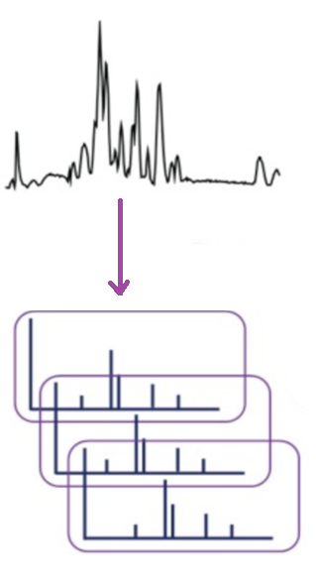
Metabolomics
Metabolomics is the most sens
Untargeted metabolomics aims to analyse entire metabolome within a biological system.
Urine contains metabolic breakdown products from
foods and drinks, drugs, environmental contaminants,
endogenous waste metabolites.
LC/ MS Fragmentation data –each metabolite gives rise to characteristic fragmentation pattern.
Rigorous and reliable annotation methods needed .
(van der Hooft et al., 2015)
Notes:
Advantages over other omics
Closest link to phenotype and reflects the actual biology of the system
Non Invasive.
Cheaper than genomics/proteomics
Annotation a major challenge for untargeted metabolomics. New tools required to remove this bottle neck.

Slide 6
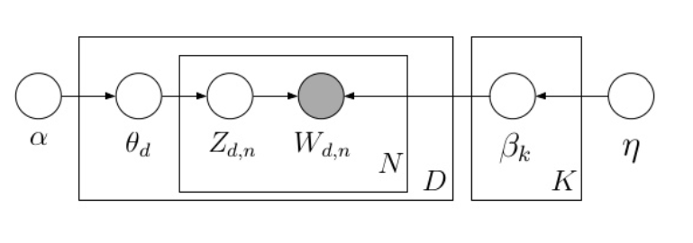
Topic Modelling Latent Dirichlet Allocation Blei,Ng,Jordan 2003 (cited 14000+ times)
Bayesian unsupervised learning model
Well establish use in document processing
From a collection of documents, infer
Per-word topic assignment zd,n
Per- document topic proportions ϴ d
Per-corpus topic distributions β k
Notes:
LDA represents documents as a mixture of topics.
It backtracks from the words into the documents to find the set of topics that is likely to have generated the document.
The observed variable are the words and the hidden variables are the topic structure and generative process that produced the data.
Documents are the set data for a sample
Words are the individual peaks.
Topics are the metabolites from which the fragments came.

Slide 7
Summarise aims of project
Identify potential biomarkers to stratify patients on
Project produce an opening hypothesis
Possibility of linking drug metabolism to other exogenous and endogenous substances.

Slide 8
Skills
Experience
Project Management Skills
MSc Bioinformatics
Research Assistant Bioelectronics
Computer Skills
Programming
Research Assistant Protein Crystallography
Running my on Business
Communication Skills
Report writing
Presentations
Collaborating
Voluntary Community work
Training and Development SVQ lll

Slide 9
My Motivation
Never lost interest in current science research
Decision to return to science.
Bioinformatics ideal match to my knowledge skills and interests
During wide based learning over past year, ive noticed areas in bioinformatics where the best techniques are not being used, and where taking ideas from other innovative developments in other areas of computer(?) science (eg text finding stoof) could really improve current research methods.
Precision medicine is a way to apply this and have a mega big impact on da lives of peeps
Although my scientific education has always been geared towards bioinformatics, I believe I have quite a broad base of scientific education, and I have always thought that the best way to improve scientific knowledge and practise is to draw on ideas from all areas of scientific progress

Slide 10
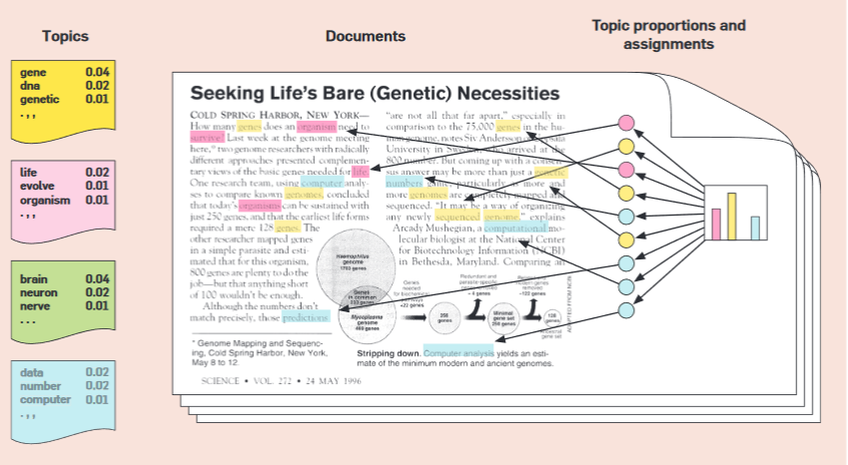

Slide 11
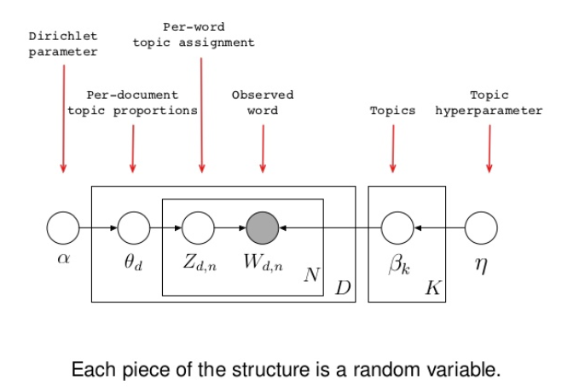
Blei

Slide 12
MSc Project
ML/Metabolomics
MSc Bioinformatics
Omics, Molecular Biology
Systems Biology Drug Discovery Programming Data Base Theory
MSc Information Technology
Programming Systems Design, Communications Theory Electronics
BSc Biophysics
Molecular Biology, Protein Crystallography, NMR, Quantum Mechanics, Physics, Mathematics, Organic Chemistry

Slide 13
My Knowledge base
ML
Metabolomics
MSc Bioinformatics
Research Assistant
MSc Information Technology
Programming, Systems Analysis and Design. Communications Theory, Electronics.
BSc Biophysics
,
Molecular Biology, Protein Crystallography, NMR , Quantum mechanics ,Medical Physics
Mathematics , Physics ,Chemistry ,Genetics

